Slide 1
Smoke detection Algorithm
Su Feng Jingcheng Deng

Slide 2
Content
Motivation
Background
Chromatic analysis
MHI
Dark channel prior
Implementation
Demo

Slide 3
Motivation
Smoke detection is important
Video based detection is challenging
Accuracy
Optimization (real time)
About the paper:
Limited information
Algorithm descriptions are too simple
Methods from referenced papers

Slide 4
Background
Chromatic analysis
A simple algorithm that picking potential smoking pixels to speed up consequent operations.
Aiming for high sensitivity but also high false positive rate.
Tradeoffs using threshold.

Slide 5
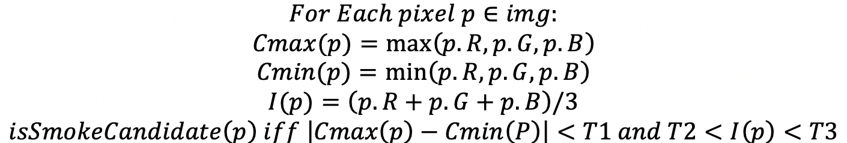
Chromatic analysis
Assume natural smoke that have greyish color.
Can be used on other special smoke.

Slide 6
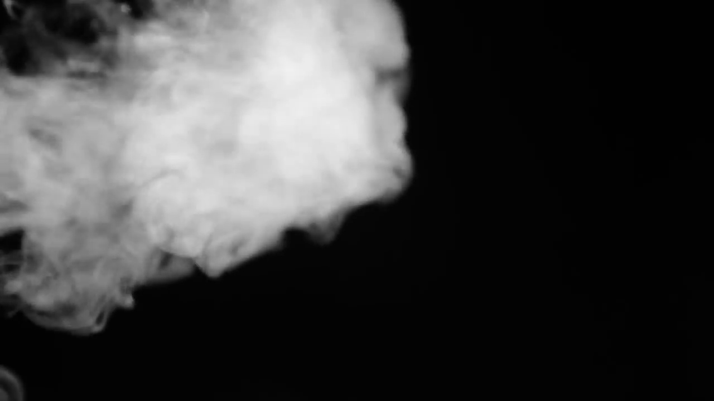

Chromatic analysis

Slide 7
Background
MHI (Motion History Image)
Record a series of frames motion in a single image template.
Keeps minimal info, space efficient.
Used to identify actively moving smoke pixels.

Slide 8
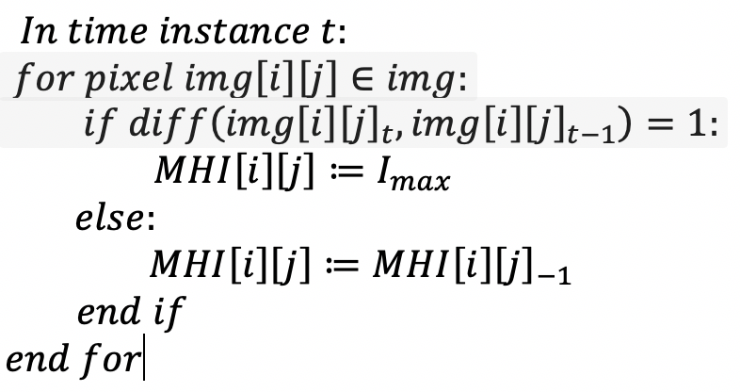
MHI
Single channel image with most recent motion in higher intensity (white).
Diff(f0, f1)

Slide 9
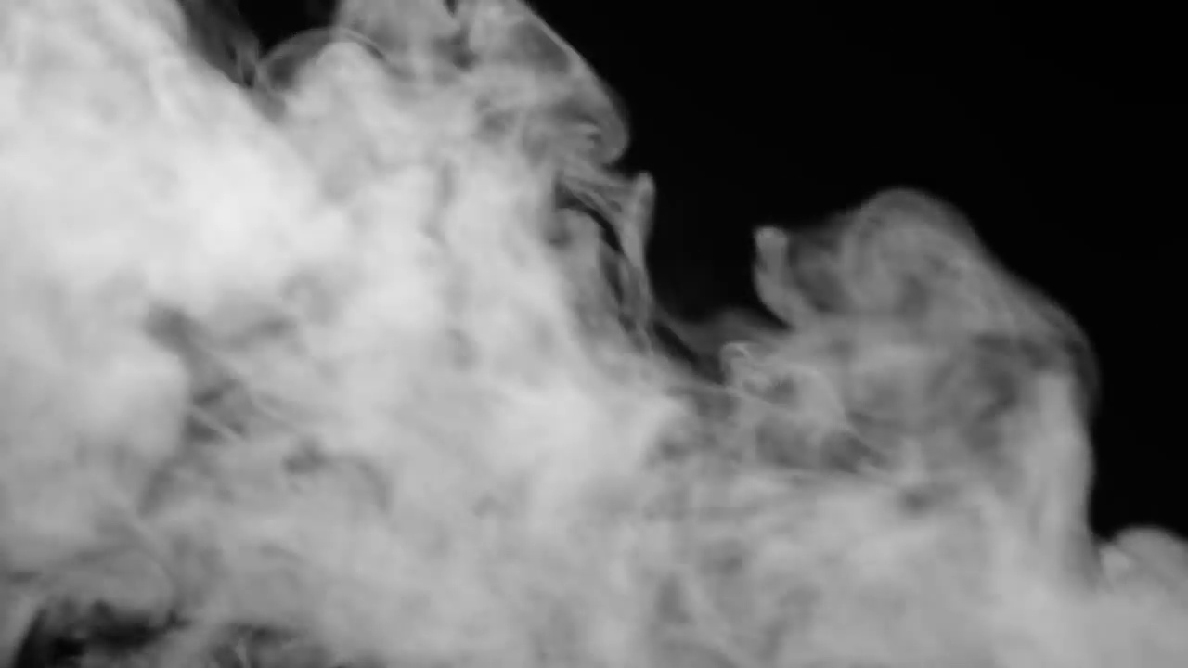
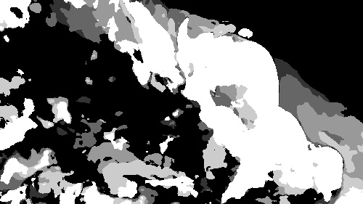
MHI

Slide 10
Background
Dark channel prior
Dark channel prior first introduced to remove haze from image
Smoke area share same characters with haze

Slide 11
Dark Channel prior
Dark channel prior
𝐼(𝑥) = 𝐽(𝑥)𝑡(𝑥) + 𝐴(1𝑡(𝑥)) where A is global atmospheric light, J is dark channel image
Simplify the equation and we can get
t(𝑥) =1−min(min(I/A))
If pixel‘s transmission less than threshold we marked it as smoke pixel

Slide 12
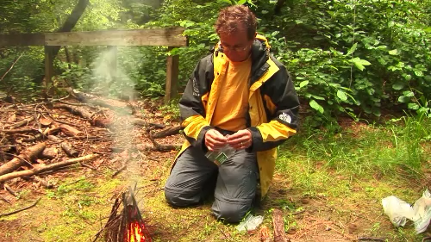
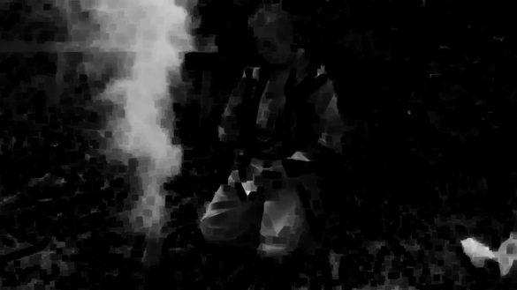


Dark channel Prior

Slide 13
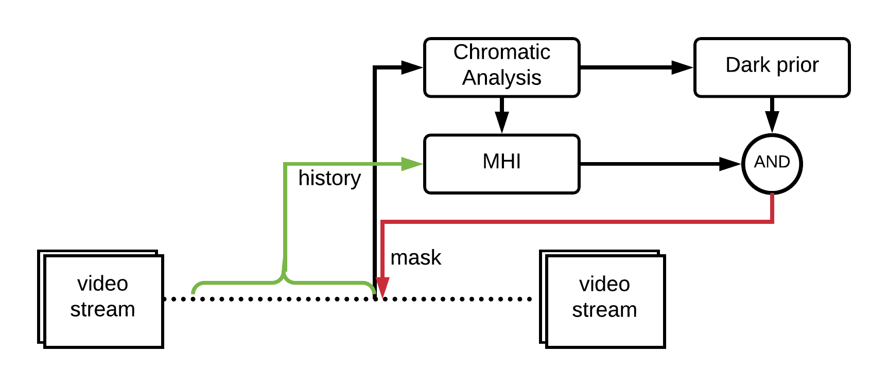
Implementation

Slide 14
Implementation
With refinement
Lower fps (lags)
Accurate smoke area indicator
Without refinement
Less lag
Lower accuracy or only show either smoke or not

Slide 15
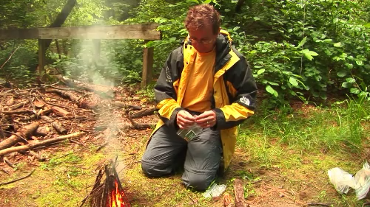
Demo

Slide 16
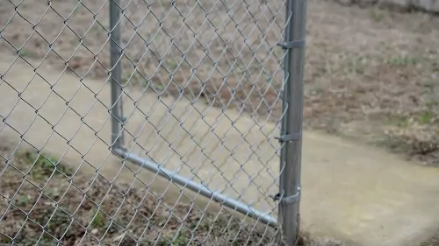
Demo

Slide 17
Future works
Block computation to optimize performance.
Also record orientation of motion in MHI to further identify the smoke movement pattern. (i.e. Histogram based analysis)

Slide 18
References
Miao Ligang, Chen Yanjun, Wang Aizhong; Video Smoke Detection Algorithm Using Dark Channel Priori; Proceedings of the 33rd Chinese Control Conference; July 28-30, 2014, Nanjing, China.
Kaiming He, Jian Sun, Xiaoou Tang; Single Image Haze Removal Using Dark Channel Prior; 978-1-4244-3991-1/09/2009 IEEE.
Feiniu Yuan; A fast accumulative motion orientation model based on integral image for video smoke detection; Pattern Recognition Letters 29 (2008) 925–932.
OpenCV motion templates https://docs.opencv.org/3.0-beta/modules/optflow/doc/motion_templates.html

